Slide 1

Exploratory Data Analysis
<Virtual Internship>
< 21-May-2024 >

Slide 2

Agenda
Problem Statement
Approach
EDA
EDA Summary
Recommendations

Slide 3
Problem Statement
XYZ is a private firm in US. Due to remarkable growth in the Cab Industry in last few years and multiple key players in the market, it is planning for an investment in Cab industry and as per their Go-to-Market(G2M) strategy they want to understand the market before taking final decision.

Slide 4
Approach
The analysis has been divided into four parts:
Data Understanding
Features generating
Hypothesis testing
Recommendation

Slide 5
EDA
The dataset
Consists of 4 datasets.
12 features for each ride in addition to 4 generated features “total 16 features”.
359392 unique datapoints “rides”.
Customer_ID
Master_dataset
Transaction_ID
City
Cab_Data

Slide 6
EDA
Assumptions
Is there significant deference between number of rides of each company among deferent cities?
Is there significant deference company's profits?
Is there a significant deference between profit average of each company among deferent cities?
Are there different preferences in different cities?
Is there a significant deference between number of users of each company?
Are there different preferences for males and females?
Are there different preferences for different age groups?
Do customer preferences differ based on income differences?
Do customers tend to repeat their experiences? If so, which company has the highest rate of repeat customers?

Slide 7
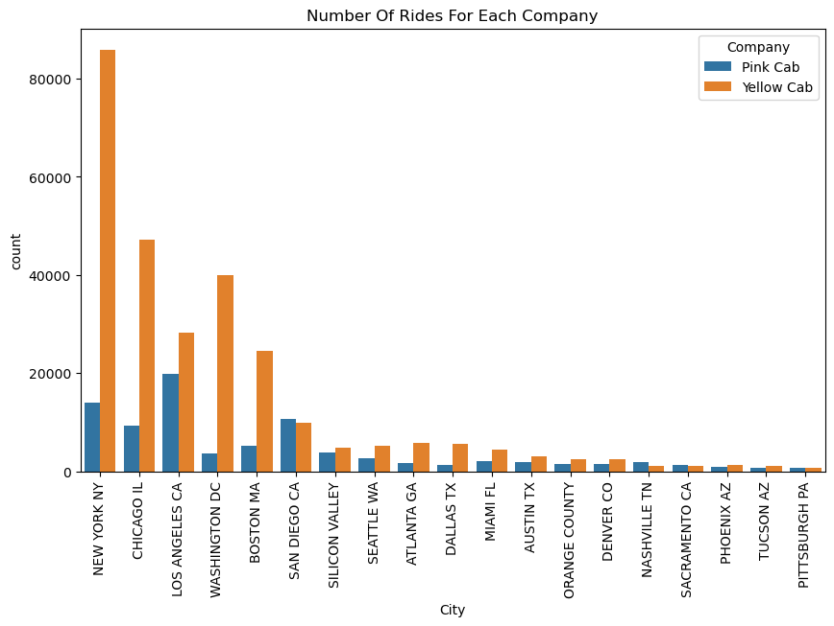
EDA Summary
Number Of Rides For Each Company/City
The chart shows that Yellow Cab company have higher number of rides in most cities

Slide 8
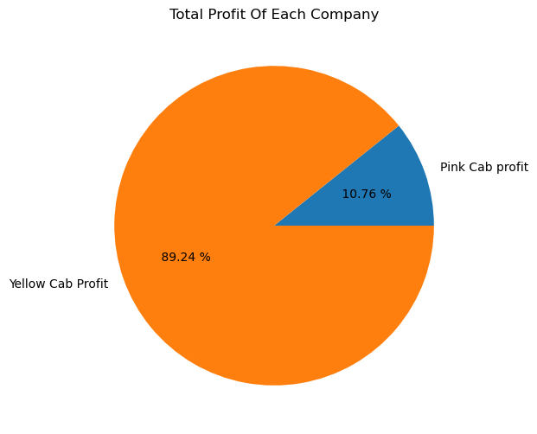
EDA Summary
Total Profit For Each Company
Is there significant deference company's profits? The chart shows that Yellow Cab company makes almost 9 times more profit than Pink Cab company.

Slide 9
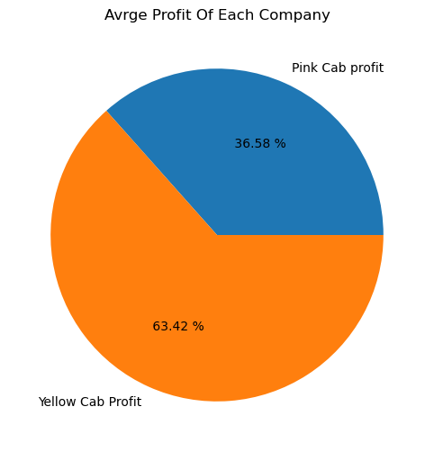
EDA Summary
Average Profit Rate Of Each Company
Is there a significant deference between profit average of each company among deferent cities? Yellow Cab company's profit average is 2 times that Pink Cab.

Slide 10
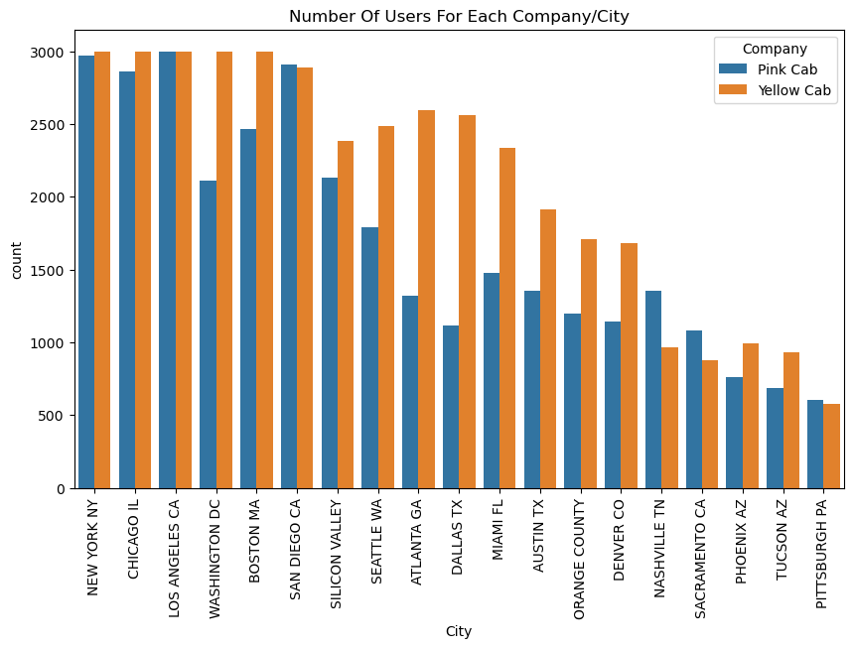
EDA Summary
Number Of Users For Each Company/City
Are there different preferences in different cities? Most users in most cities prefer Yellow Cab company

Slide 11
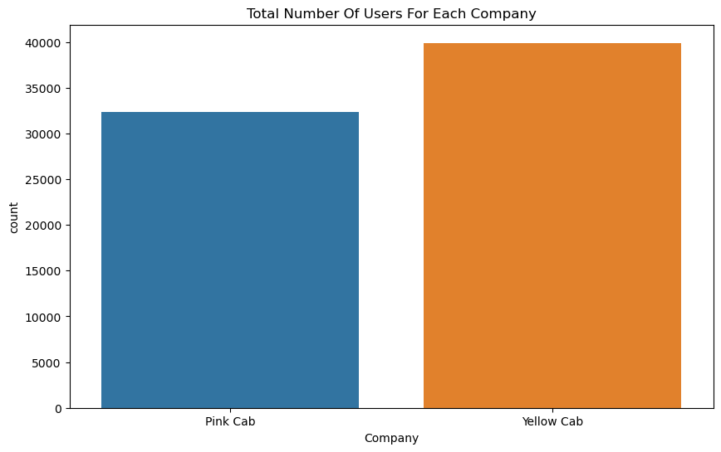
EDA Summary
Total Number Of Users For Each Company
Is there a significant deference between number of users of each company? Total number of Yellow Cab company users is more than Total number of Pink Cab company users

Slide 12
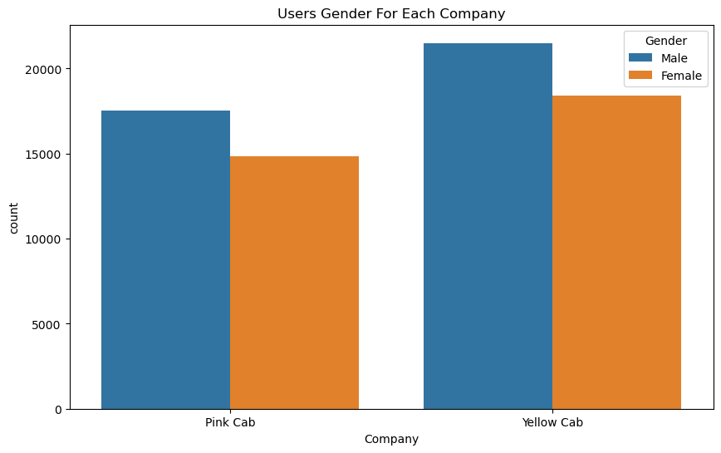
EDA Summary
Users Gender For Each Company
Are there different preferences for males and females? No, The ratio of males and females is similar in both companies.

Slide 13
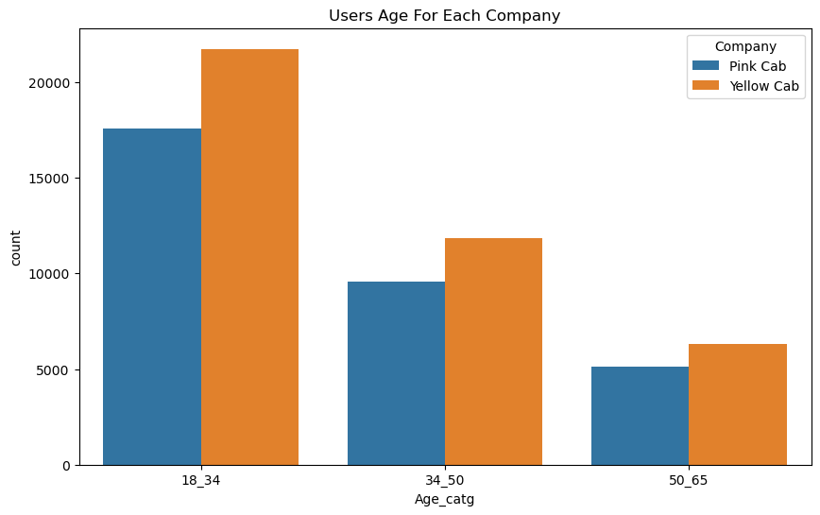
EDA Summary
Users Age For Each Company
Are there different preferences for different age groups? Yellow Cab company have the majority of users among all age groups.

Slide 14
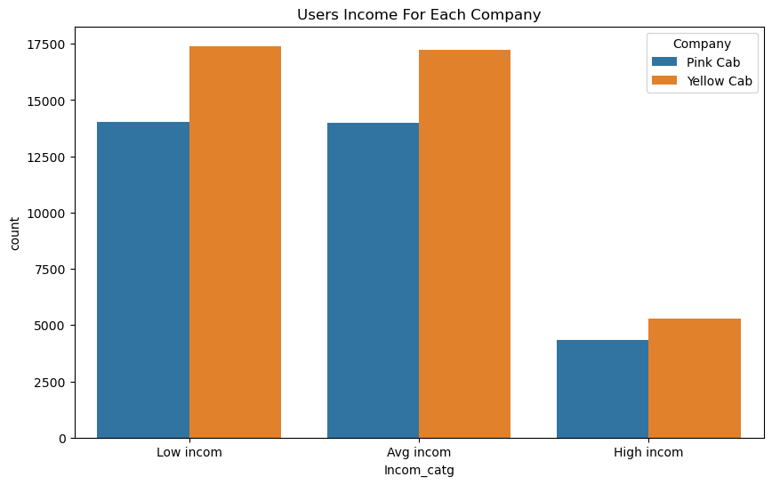
EDA Summary
Users Age For Each Company
Do customer preferences differ based on income differences? No, the Yellow Cab Company is the preferred choice for people across different income groups.

Slide 15
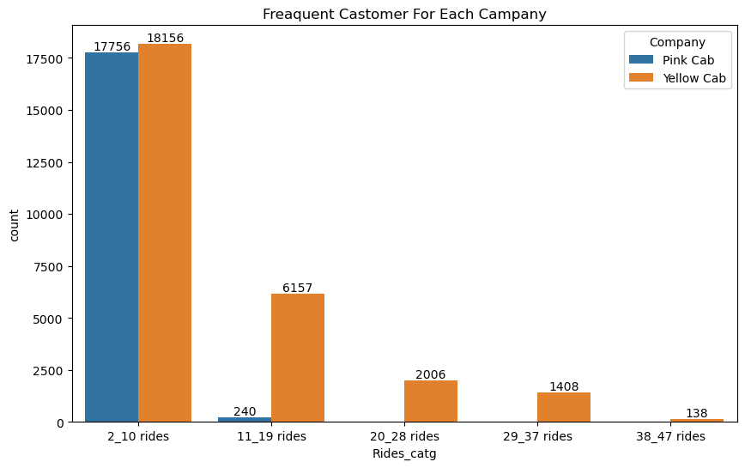
EDA Summary
Users Age For Each Company
Do customers tend to repeat their experiences? If so, which company has the highest rate of repeat customers? Many users used the service once, but it seems that yellow company's users are more likely to repeat their experience.

Slide 16
Recommendations
Based on the data analysis, it is recommended that the client invest in the Yellow Cab company.

Slide 17
Thank You

